Slide 1

Music Genre
Recognition
Qiao Hu

Slide 2
Source Data
audio files: mp3, ogg, wav etc.
genres: [slow, pop, intense]
42 in total
44100 fps * 274 seconds
10,908,288 frames per song

Slide 3

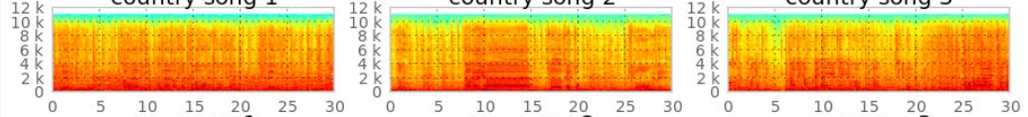
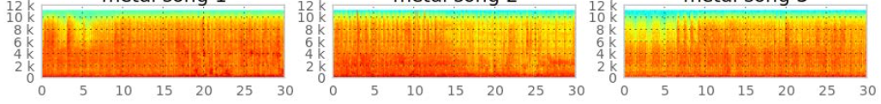
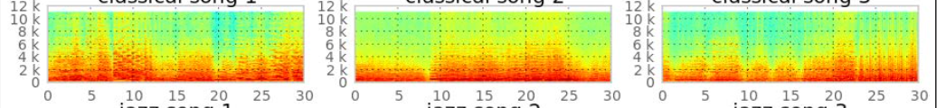
InFORMATION RETRIeVAL
Digital Analog - convert audios files to .wav by ffmpeg

Slide 4
InFORMATION RETRIeVAL
Analog Features
Trim head and tail of audio input
Apply MFCC (Mel Frequency Cepstral Coefficient)
Frame the signal into short frames.
For each frame calculate the periodogram estimate of the power spectrum.
Apply the mel filterbank to the power spectra, sum the energy in each filter.
Take the logarithm of all filterbank energies.
Take the DCT of the log filterbank energies.
Keep DCT coefficients 2-13, discard the rest.
Output in .npy format

Slide 5
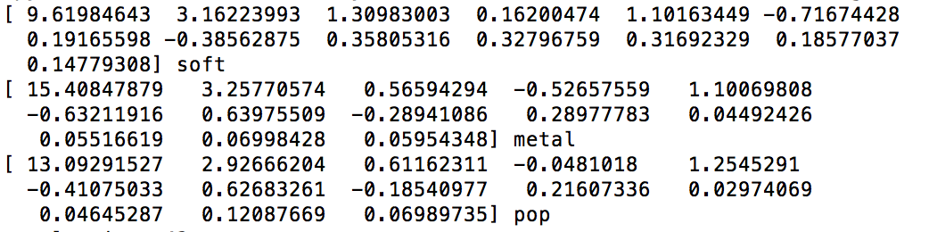
Classifiers
Input and Output
Randomly select
Training 75%
Test 25%

Slide 6

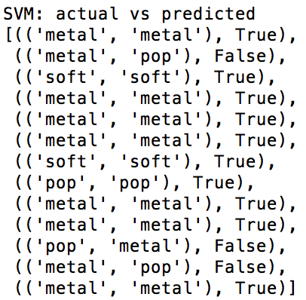
SVM

Slide 7
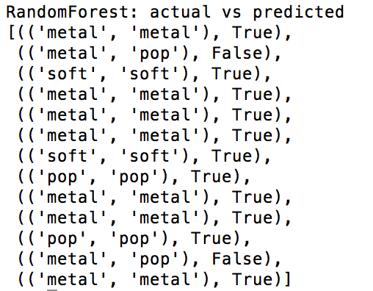
Random Forest

Slide 8

Conclusions
I prefer SVM
Lots of room for improvement

Slide 9

References
Page 199 - 218 Chap 9 of book
Python
mfcc,glob,scipy, sklearn

